Slide 1
W266 Natural Language Processing
Language Modeling 1

Slide 2
Agenda
Reminders
Where are we?
Counting!
Notebook: Playing with a real n-gram language model

Slide 3
Reminders!
Use Piazza for all questions
Lower latency for you; load balancing for us
Really nice to see students helping each other
Assignment 1 is done
Solutions presented in recorded OH last weekend
Assignment 2 will be released by the end of the week
Release dates & deadlines have shifted around on the syllabus, please double check!
Feel free to submit project proposals as soon as you have a strong proposal put together

Slide 4
Peeking ahead...
Week 1: Introduction
Week 2-3: Classification & Sentiment
Week 4 - 5: Language Modeling & Representations
N-gram models
Neural Language Models (RNNs, LSTMs)
Week 6 - 7: Machine Translation
Week 8: Summarization
Week 9: Part of Speech Tagging
Week 10 - 11: Parsing
Week 12: Search
Week 13: Entities, Relations, and Coreference
Week 14: Project Presentations

Slide 5

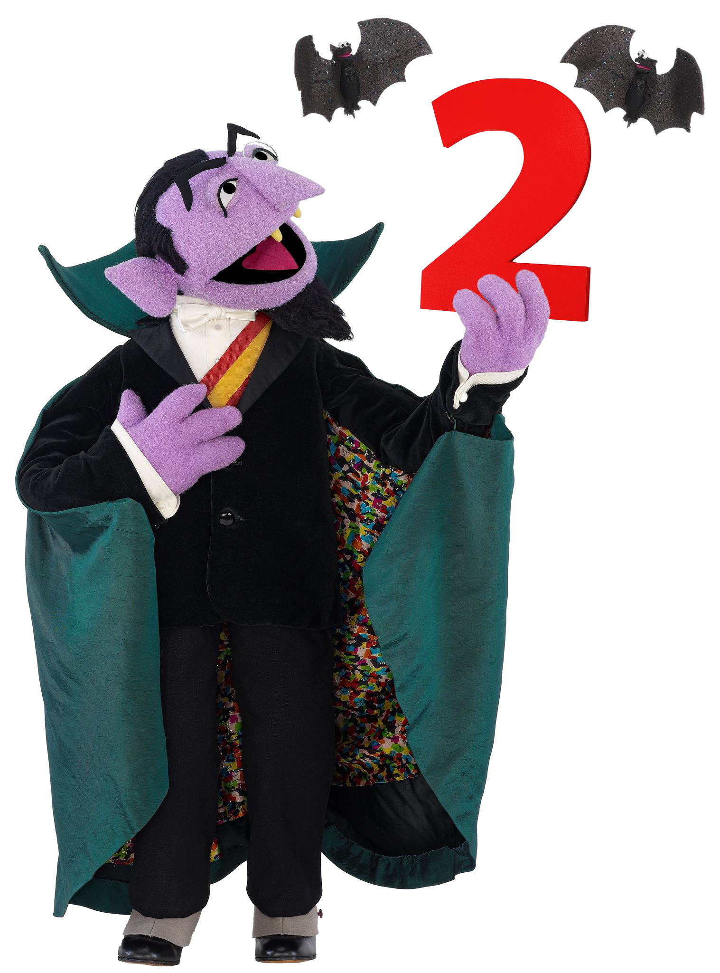

N-gram models
Last week: Deep Learning™
This week: counting words
Notes:
Next week (word embeddings): ¿Por que no los dos?

Slide 6
N-grams
What is an n-gram?
[this is a sentence .] (5 tokens)
Unigrams (tokens):
[this] [is] [a] [sentence] [.]
Bigrams:
[<s> this] [this is] [is a] [a sentence] [sentence .] [. </s>]
Trigrams:
[<s> <s> this] [<s> this is] [this is a] [is a sentence]
[a sentence .] [sentence . </s>] [. </s> </s>]

Slide 7
N-grams
What is an n-gram model?
A probability distribution for each prefix, of what might come next:
[the, cat, in, the] -> “hat”
hat 0.8
bird 0.08
fish 0.08
hamburger 0.000001
...

Slide 8
Unsmoothed Maximum Likelihood
“the potato is smaller than the tomato”
What counts do you need to score P(potato | the)?

Slide 9
Unsmoothed Maximum Likelihood
c(the, potato) and c(the)
“the potato is smaller than the tomato”
What counts do you need to score P(potato | the)?

Slide 10
Unsmoothed Maximum Likelihood
“the potato is smaller than the tomato”
What are their values?
c(the) ?
c(the, potato) ?

Slide 11
Unsmoothed Maximum Likelihood
c(the) = 2
c(the, potato) = 1
“the potato is smaller than the tomato”
What are their values?
c(the) ?
c(the, potato) ?

Slide 12
Unsmoothed Maximum Likelihood
“the potato is smaller than the tomato”
What is P(potato | the)?

Slide 13
Unsmoothed Maximum Likelihood
P(potato | the)
= c(the, potato) / c(the)
= 1 / 2
= 0.5
“the potato is smaller than the tomato”
What is P(potato | the)?

Slide 14
N-grams
What is an n-gram model?
How does it relate to the article you read in the first week about the “grounding” of NLP models?

Slide 15
N-grams
What is an n-gram model?
Why do we care? What are they used for?

Slide 16
N-grams
What is an n-gram model?
Why do we care? What are they used for?
Score a run of text for how well it belongs to a language.
(Can also generate nonsense text by sampling!)

Slide 17
N-grams
What is an n-gram model?
Why do we care? What are they used for?
Many algorithms in NLP of the form:
Enumerate all the options (or at least all the promising-looking ones)
Score them all and pick the best
e.g. Segment “thecatinthehat”:
[“t”, “hecatinthehat”]: 0.001
[“the”, “cat”, “in”, “the”, “hat”]: 0.8

Slide 18
N-grams
What is an n-gram model?
Why do we care? What are they used for?
Spell correction:
P(intended | typed) ∝ P(typed | intended) x P(intended)
Example implementation: http://norvig.com/spell-correct.html

Slide 19
N-grams
What is an n-gram model?
Why do we care? What are they used for?
What are some problems with them?

Slide 20
N-grams
What is an n-gram model?
Why do we care? What are they used for?
What are some problems with them?
Sparsity?
Markov assumption?

Slide 21
N-grams
What is an n-gram model?
Why do we care? What are they used for?
What are some problems with them?
Sparsity
Longer n-grams vs. sparsity
OOV and numbers
Markov assumption
Anaphora/long range dependencies
Directionality

Slide 22
N-grams
What is an n-gram model?
Why do we care? What are they used for?
What are some problems with them?
Why do we talk about smoothing? What problem does it solve?

Slide 23
AddK & Kneser-Ney

Slide 24
Add K: Intuition
c(w_{i-2}, w_{i-1}, w_{i}) + K
P(w_{i} | w_{i-1}, w_{i-2}) =
c(w_{i-2}, w_{i-1}) + K |V|
Pretend you’ve seen every word K times in every context before you start counting
Questions:
How many (extra) times do you pretend you’ve seen each context?
If K is reasonably big, what does this do to your estimates?

Slide 25
Ngram model
c(w_{i-2}, w_{i-1}, w_{i}) + K
P(w_{i} | w_{i-1}, w_{i-2}) =
c(w_{i-2}, w_{i-1}) + K |V|
“the potato is smaller than the tomato”
What is P(potato | the)?
(Assume Add-K Smoothing with K=5.)

Slide 26
Ngram model
P(potato |the)
= (c(the, potato) + K) / (c(the) + KV)
= (1 + 5) / (2 + 5 * 6)
= 6 / 32
= 0.1875
“the potato is smaller than the tomato”
What is P(potato | the)?
(Assume Add-K Smoothing with K=5.)

Slide 27
Ngram model
“the potato is smaller than the tomato”
What if your vocabulary was 10000?
(Assume Add-K Smoothing with K=5.)

Slide 28
Ngram model
P(potato |the)
= (c(the, potato) + K) / (c(the) + KV)
= (1 + 5) / (2 + 5 * 10000)
= 6 / 50002
= 0.0001199952
Hrmmm..
“the potato is smaller than the tomato”
What if your vocabulary was 10000?
(Assume Add-K Smoothing with K=5.)

Slide 29
Kneser-Ney: Intuition
Idea: Use all available evidence.
Mechanism:
“Steal” probability from n-gram model
Give it to the (n-1)-gram model
Recurse!
How much probability to steal?
Plus: use of “type fertility” in place of traditional unigram model.

Slide 30
K-N Smoothing
“the potato is smaller than the tomato”
What is the type fertility of “the”?
What is the type fertility of “potato”?

Slide 31
K-N Smoothing
the: 2
(comes after “<s>” and “than”)
potato: 1
(comes after “the”)
“the potato is smaller than the tomato”
What is the type fertility of “the”?
What is the type fertility of “potato”?

Slide 32
K-N Smoothing
“the potato is smaller than the tomato
the potato”
What is the type fertility of “the” now?
What is the type fertility of “potato” now?

Slide 33
K-N Smoothing
the: 3
(comes after “<s>” and “than”, “tomato”)
potato: 1
(comes after “the”)
“the potato is smaller than the tomato
the potato”
What is the type fertility of “the” now?
What is the type fertility of “potato” now?

Slide 34
A few more notes on word embeddings...

Slide 35
Take some time to play...
If you haven’t already, please spend some time looking through...
-> Jupyter Notebook: simple_lm <-

Slide 36
Clustering words for language models
Are there drawbacks of modeling all words separately?
Words that described similar types of things can be used in similar contexts. Specific contexts will not be observed with all words having the same type (e.g. city names)
What if we modeled: P(<city name> | "always wanted to visit")
Train like to fly to honolulu 20 just flew back from beijing 10 just flew back from boston 35 just flew back from honolulu 65 i grew up near dallas 5 I grew up near boston 3 moved back home from chicago 8 moved back home from dallas 8 always wanted to visit london 7 always wanted to visit boston 5 Evaluation/Application always wanted to visit beijing ?
Notes:
Would be nice if we can bridge between contexts, by multi-hop reasoning: {beijing, boston, honolulu} are similar, and {boston, london} are similar, so maybe {london, beijing} are similar, transitively?

Slide 37
What about different ways words can be similar?
Is a single cluster category enough for each word?
Numerous ways one word can be similar to another
Not always categorical (e.g., likely location for a tech startup) Important dimensions differ based on application.
honolulu | la | cancún | florida has great beaches washington | beijing | congress issued a new policy... boston | montreal | fargo buried by snow... honolulu | sf have wet mild winters The tech startup from sf | seattle | boston | austin | boulder ...
Notes:
Brown clusters can give us a taxonomy of sorts, if we keep track of how clusters merge as the algorithm runs to completion. But this ends up being a fairly crude measure of similarity - it can tell you that two things are in the same branch (which might be cities), but it won’t be able to simultaneously capture other attributes that cut across categories (like “mild winters” - a property of both “sf” and “california” but not of “boston”).

Slide 38
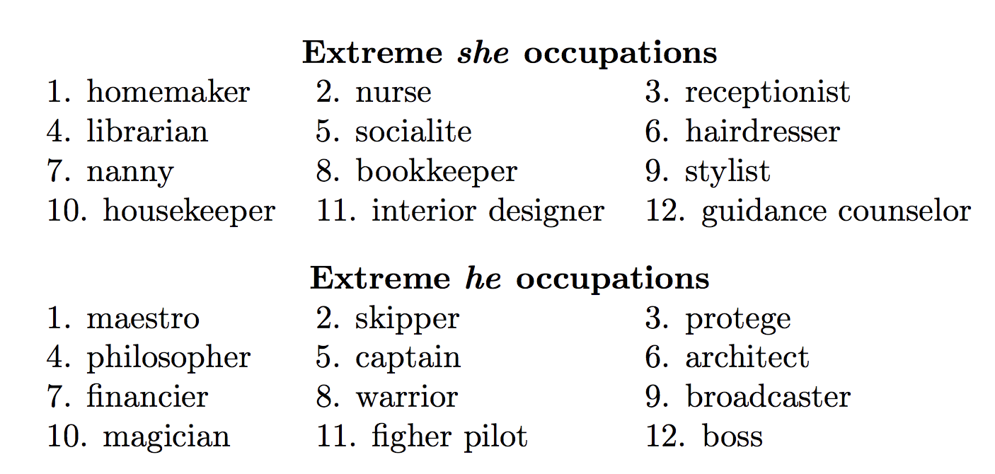
Model Bias
Biased data results in biased representations Models representations capture stereotypes (e.g., gender, racial) and implicit biases in language usage.
Representations can be used to study biased language
Debiasing Critical for fairness in downstream applications Identify and adjust representations to eliminate or soften
Key Idea Identify subspace that captures bias Ensure differences between neutral words do not differ (or minimal differ) due to biased subspace
http://blog.conceptnet.io/posts/2017/how-to-make-a-racist-ai-without-really-trying/
Bolukbasi et al. 2016

